Slide 1

How to choose Colors using matplotlib.cm

Slide 2

Reference
Chapter 13 (O'Reilly) of Hands-On ML
Hvass Lab’s GitHub and Youtube
Youtube on Inception v3 2015
Youtube on CIFAR10
Youtube on Pickle
Youtube on Transfer Values
Youtube on PCA of Transfer Values
Youtube on t-SNE of Transfer Values
Youtube on Transfer Learning
Youtube
Code

Slide 3
CIFAR10 Download

Slide 4
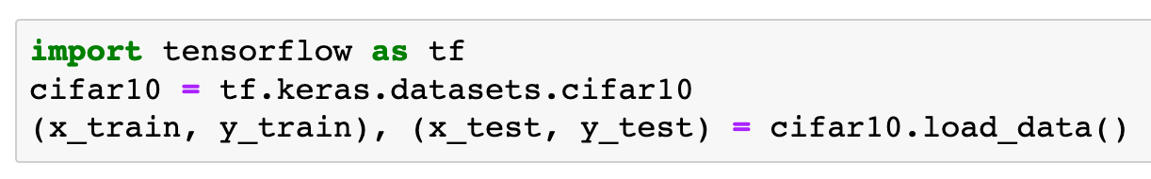

Slide 5
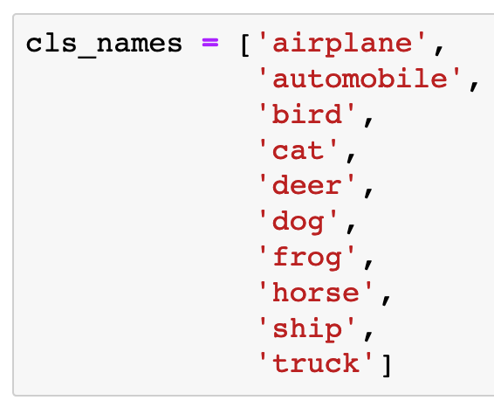

Slide 6
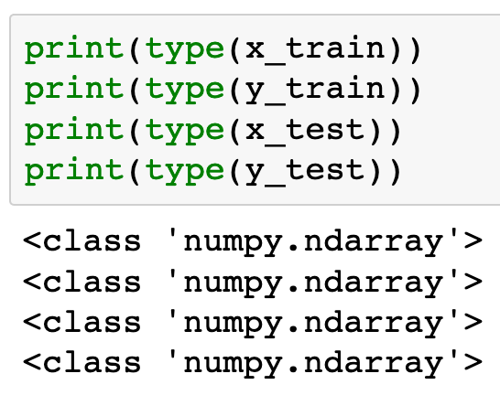

Slide 7
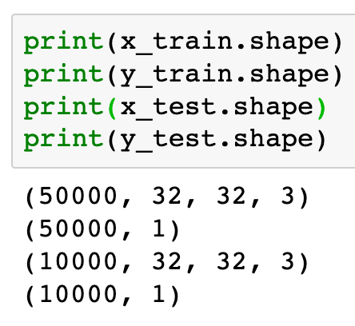

Slide 8
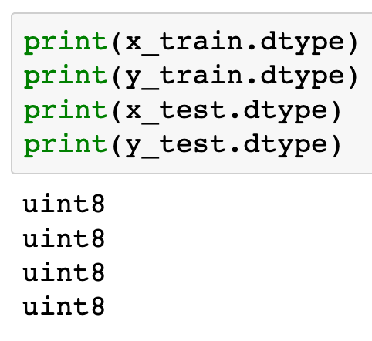

Slide 9
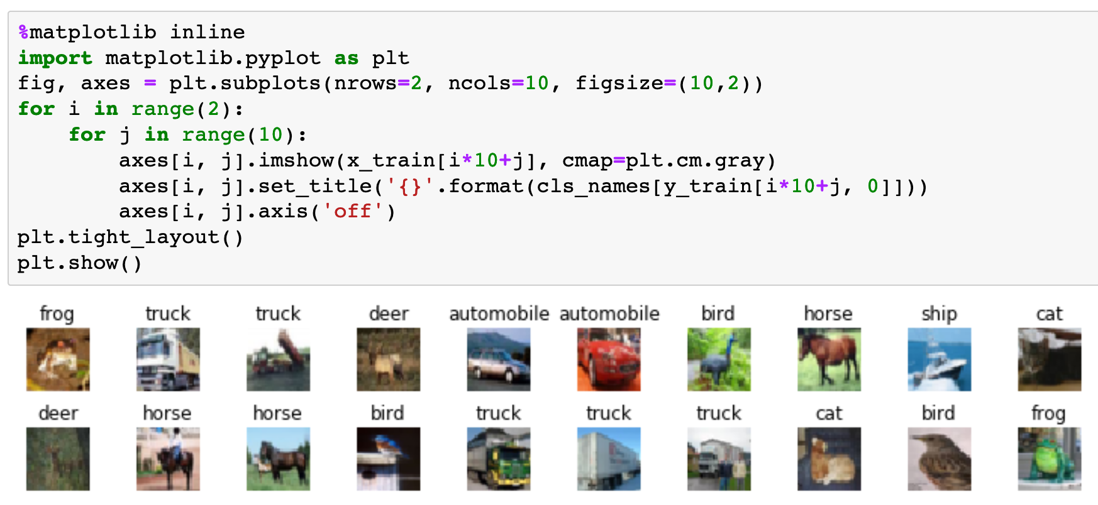

Slide 10
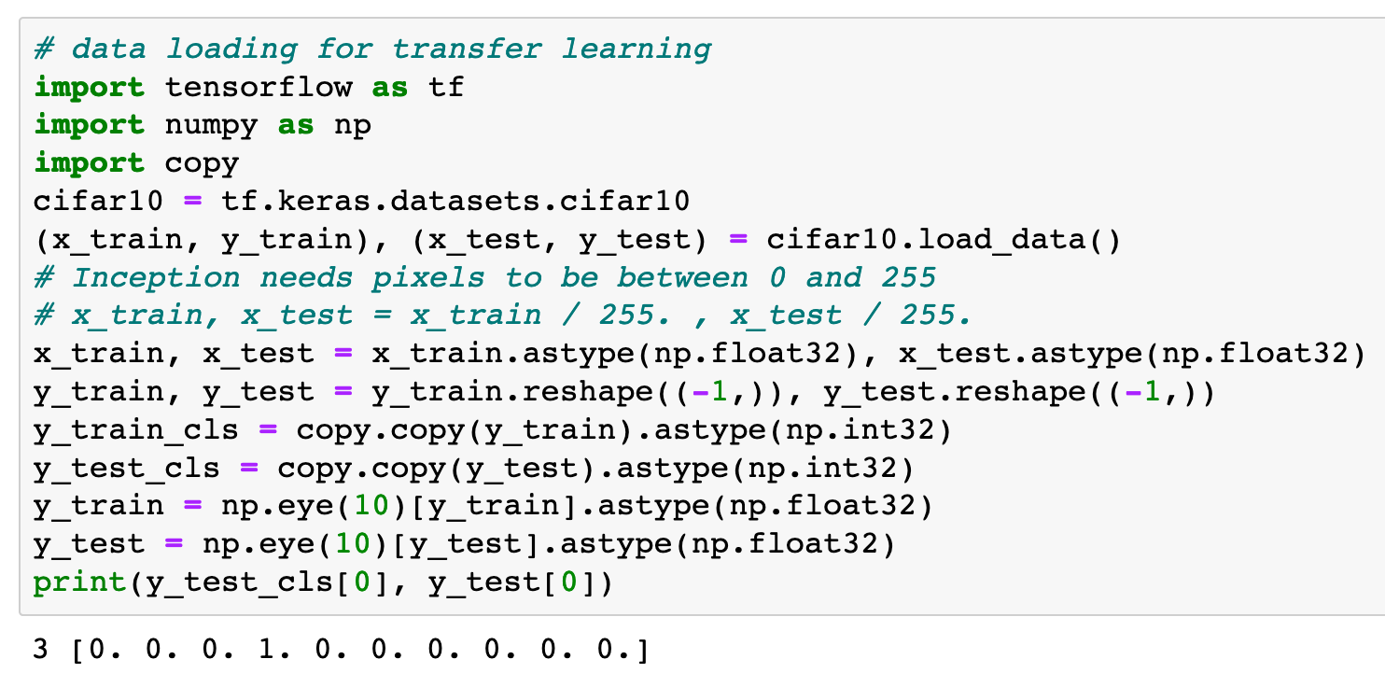

Slide 11
Compute or Restore
Transfer-Values

Slide 13
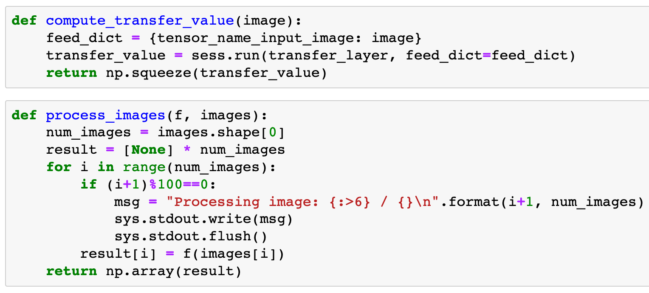


Slide 16
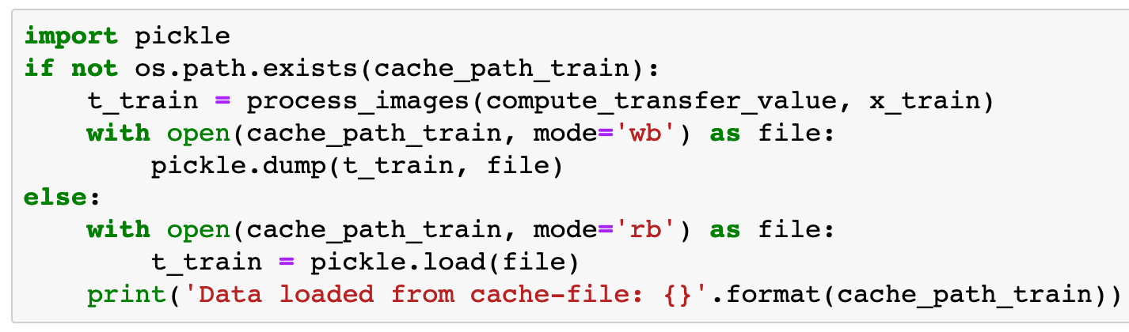
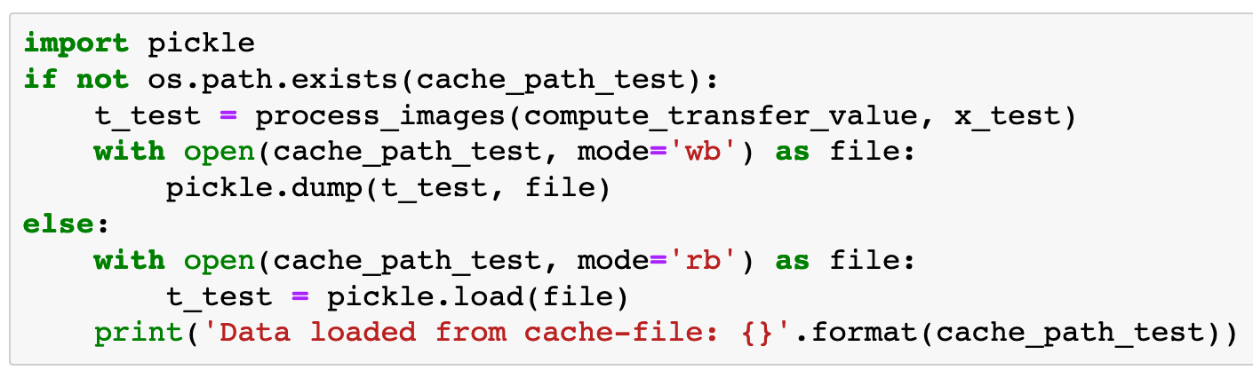

Slide 17
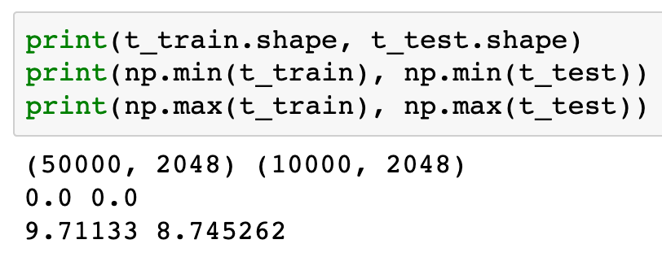

Slide 18
PCA

Slide 19
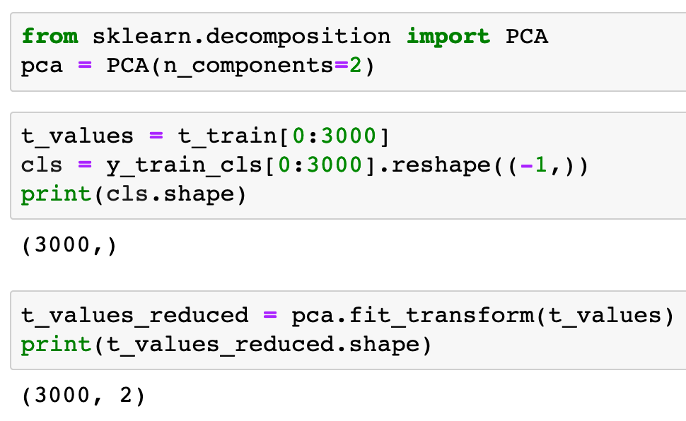


Slide 22
matplotlib.cm

Slide 23
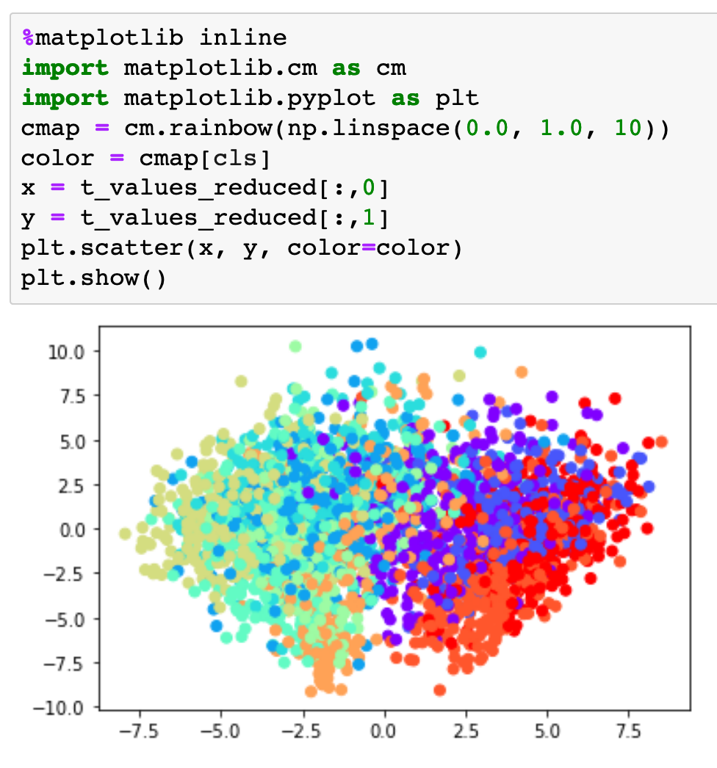

Slide 24
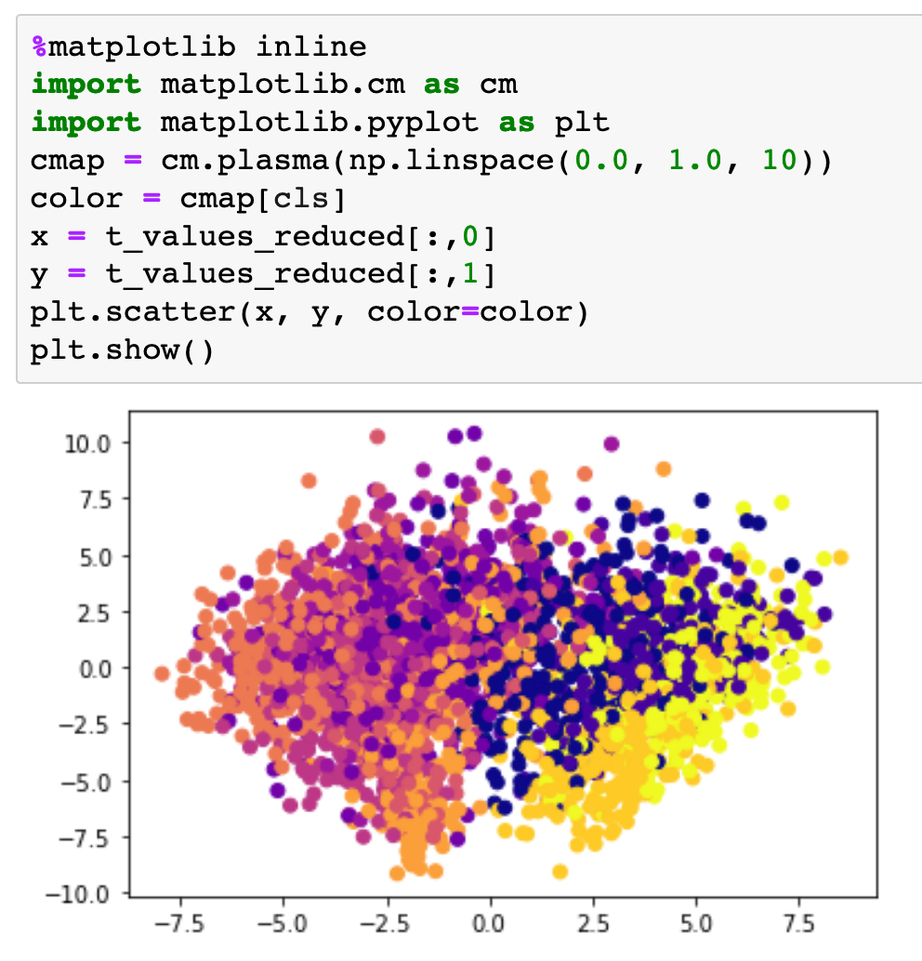

Slide 25
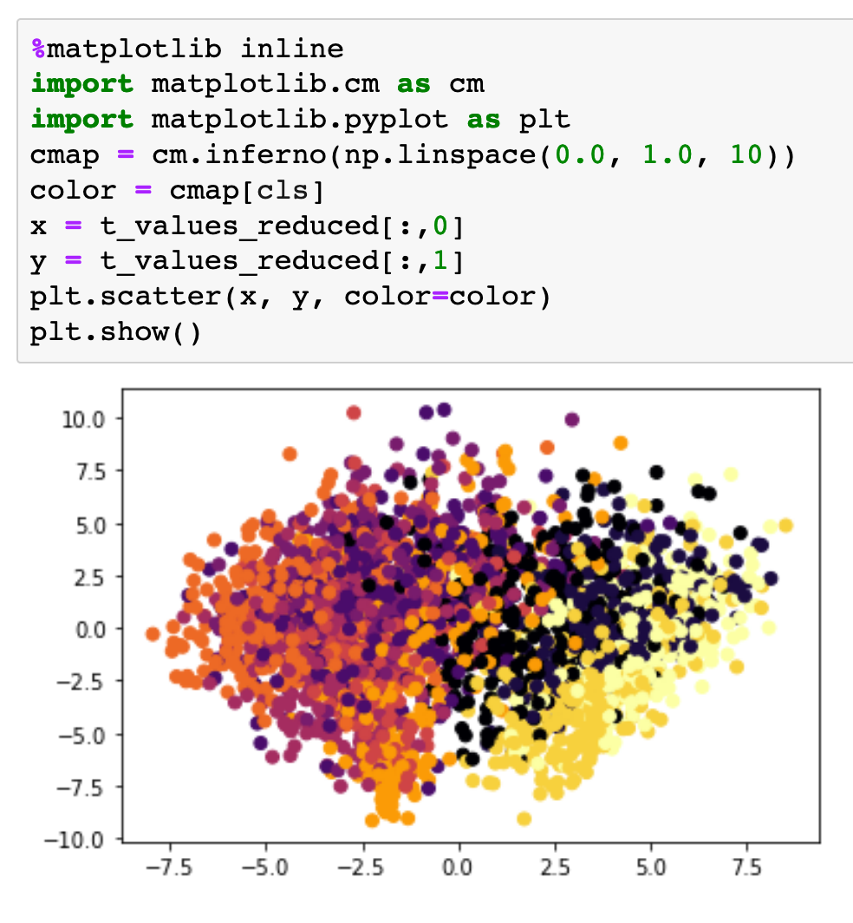

Slide 26
plt.get_cmap

Slide 27
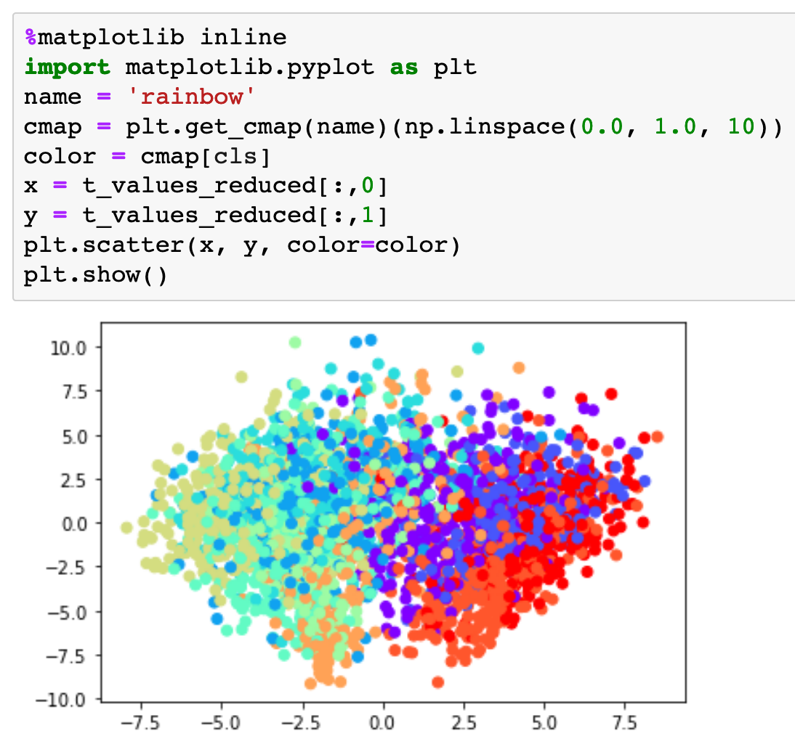

Slide 28
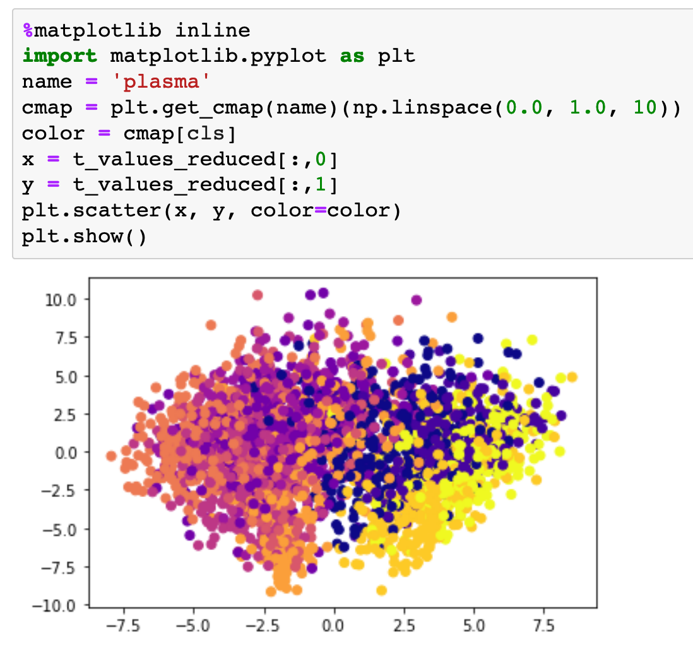

Slide 29
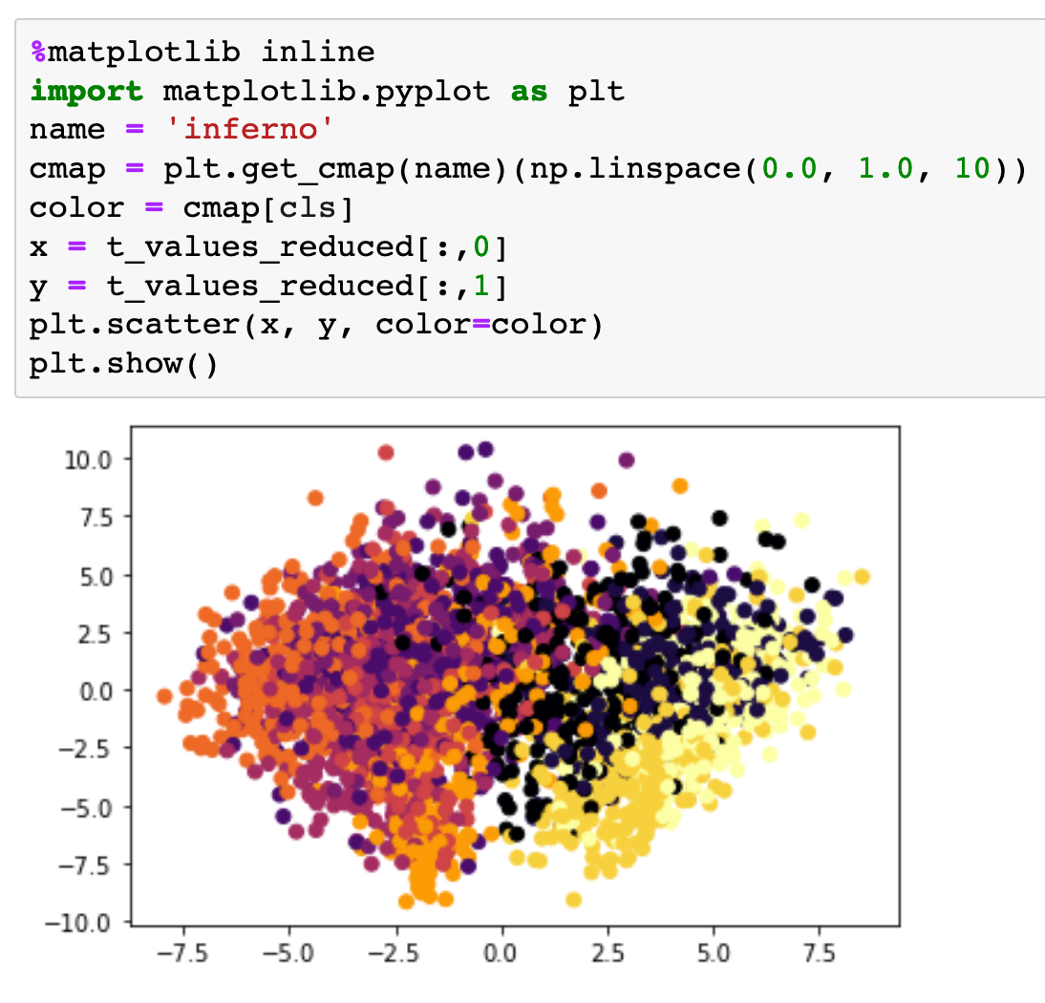

Slide 30
RGBA

Slide 31
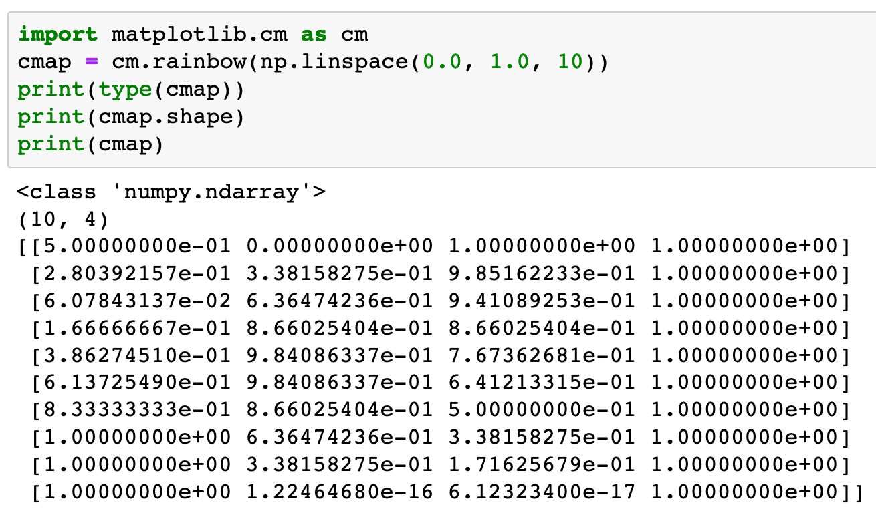

Slide 32
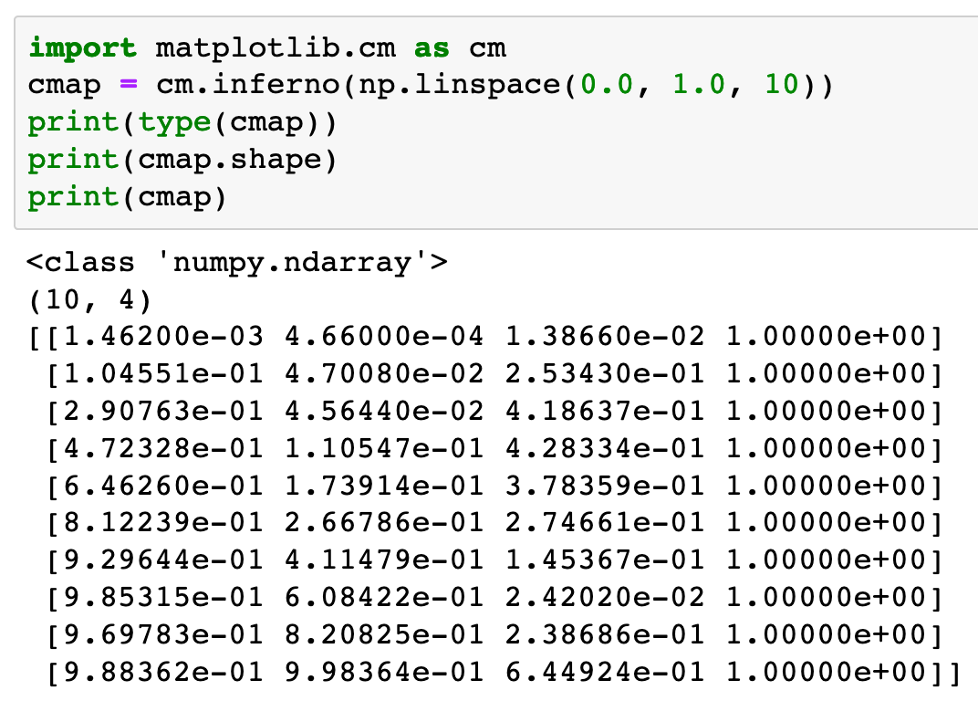

Slide 33
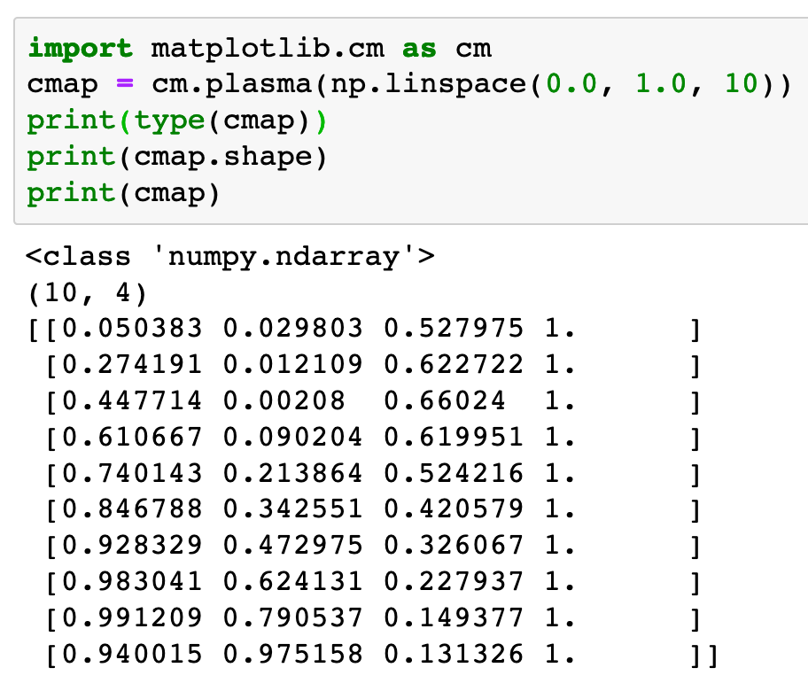

Slide 34
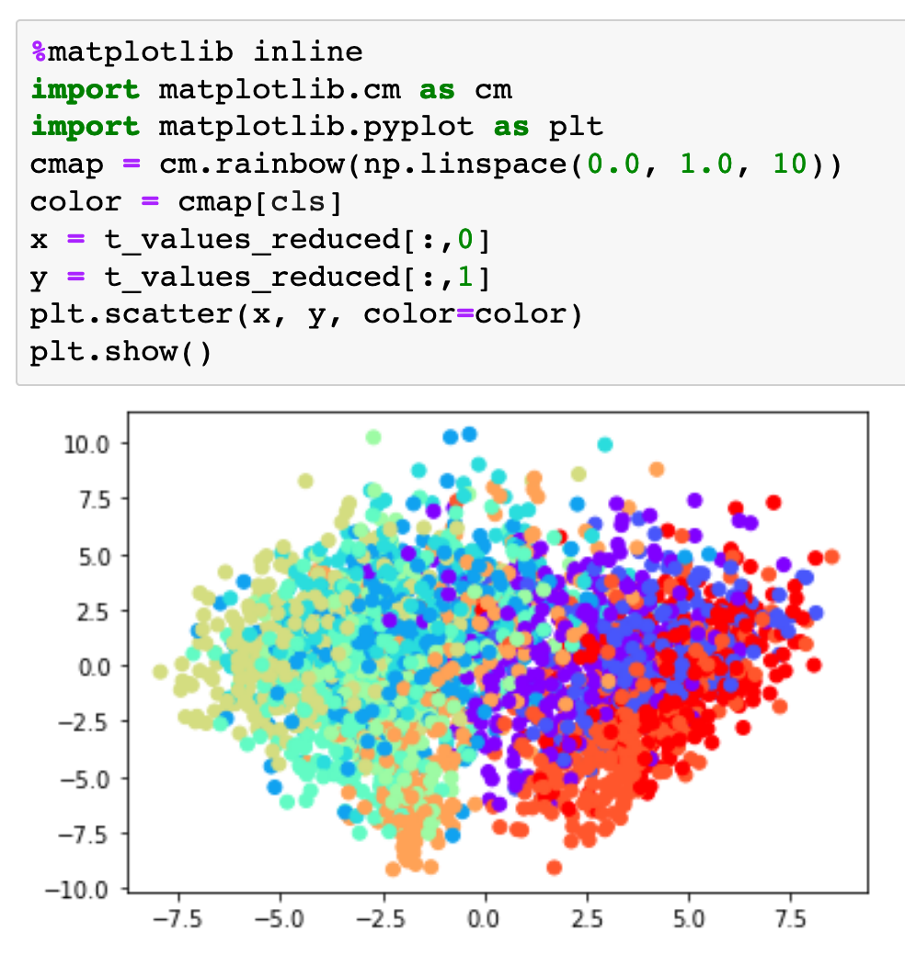

Slide 35
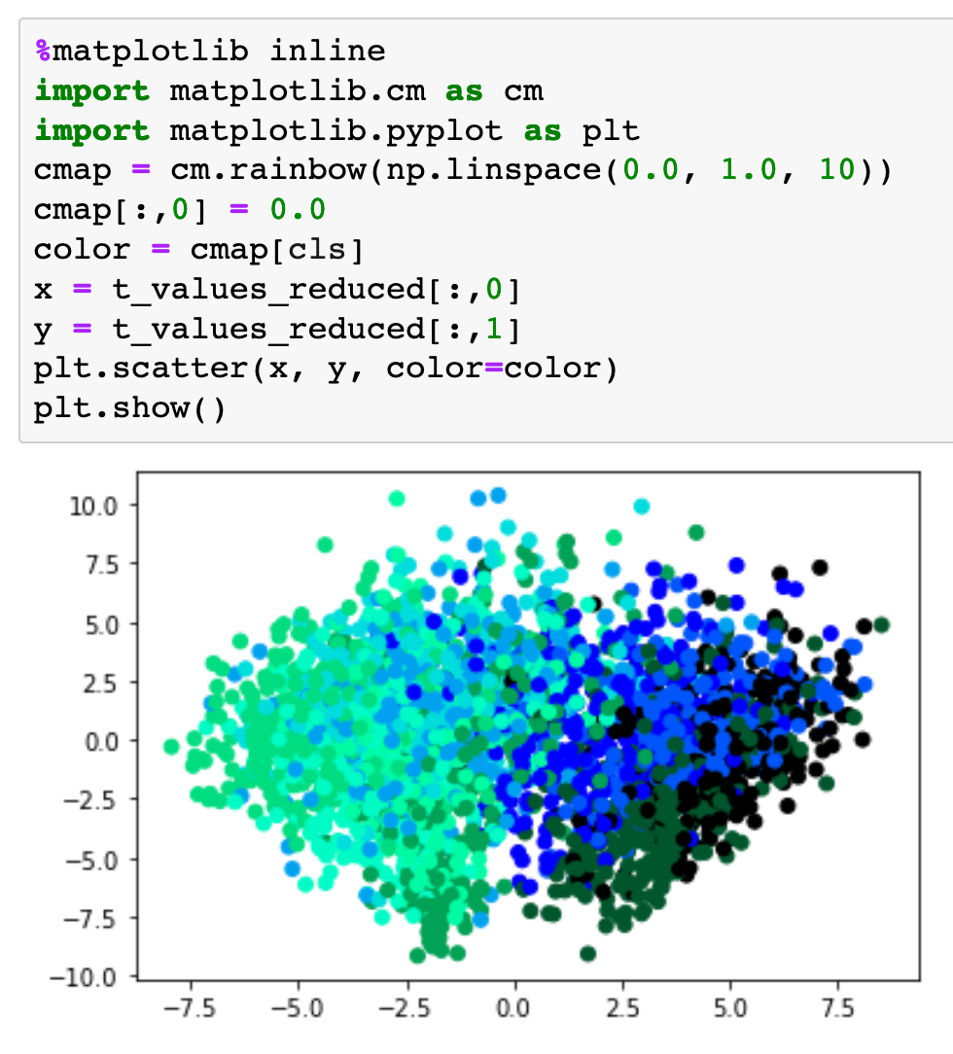

Slide 36
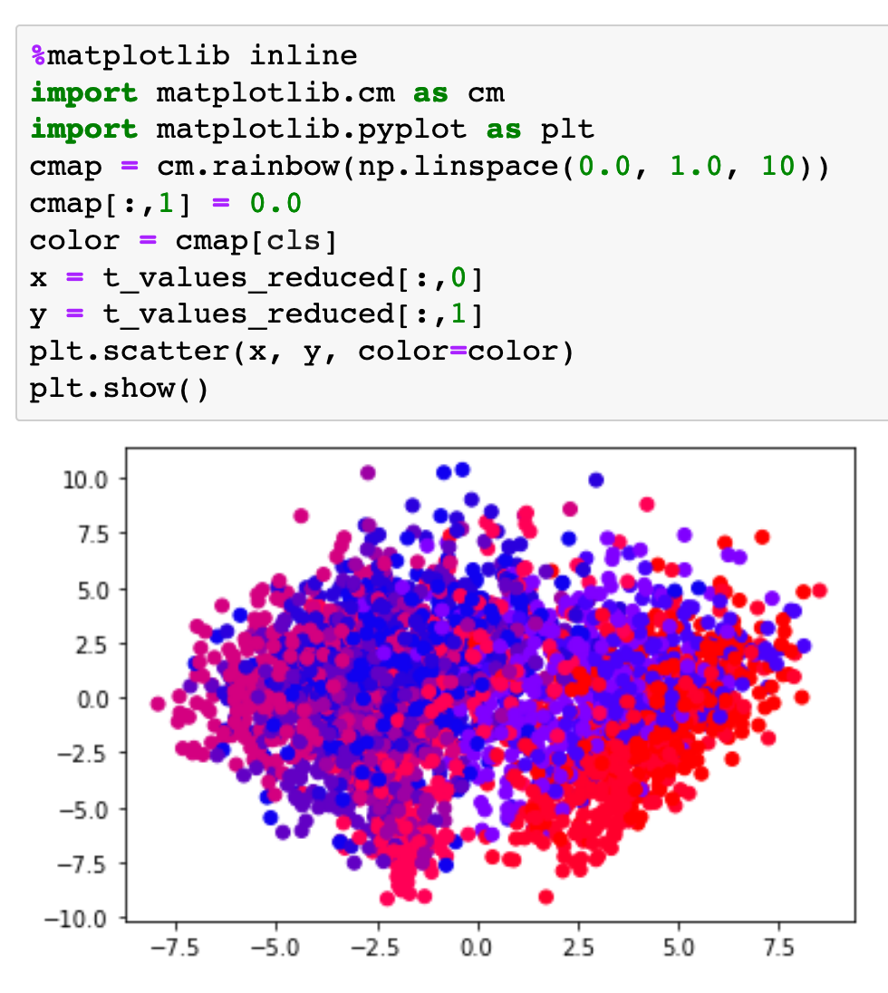

Slide 37
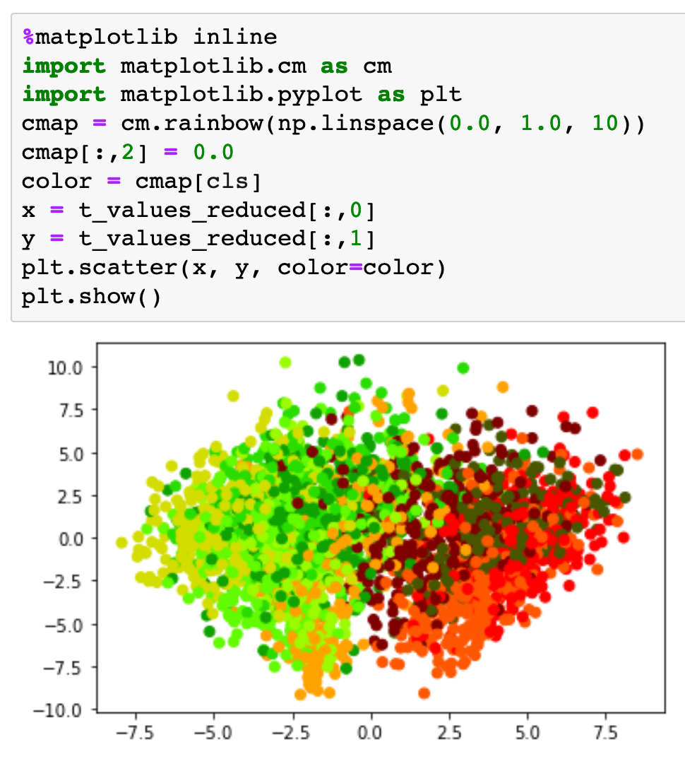

Slide 38
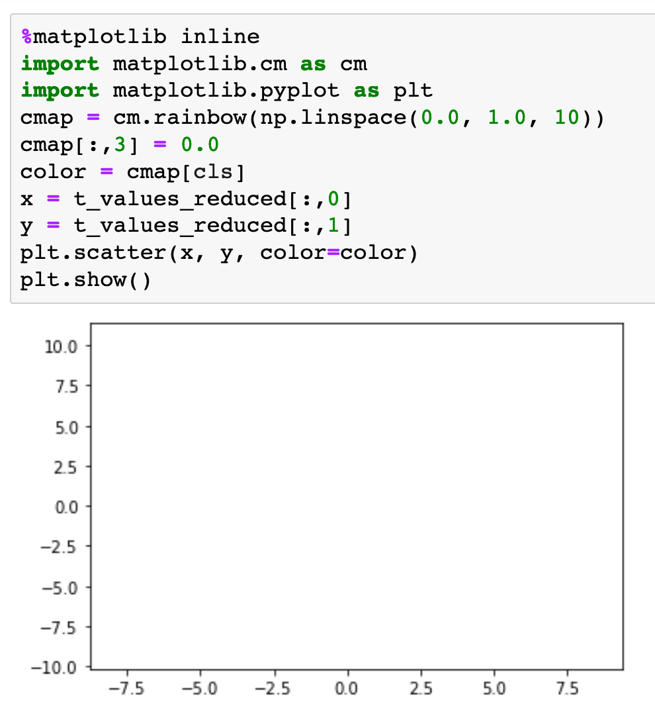

Slide 39
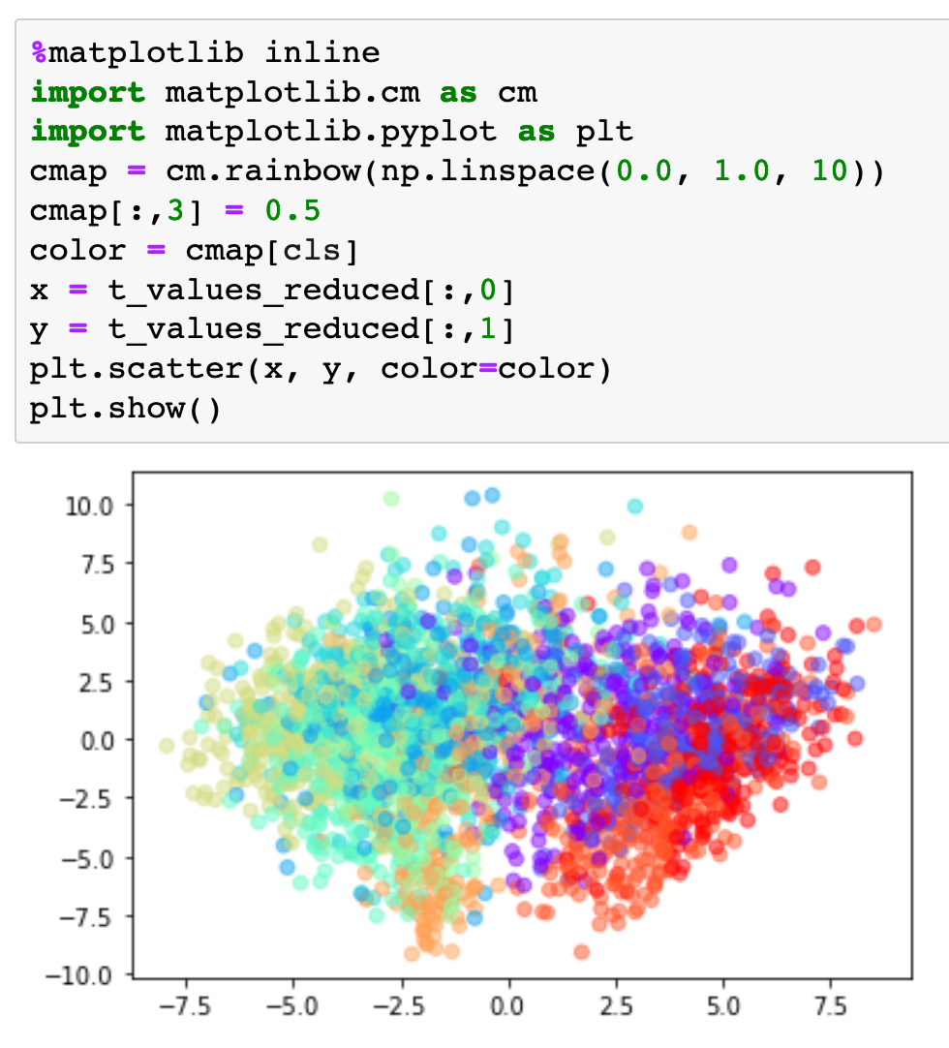

Slide 40
Now
Let’s Play with Code

